Slide 1
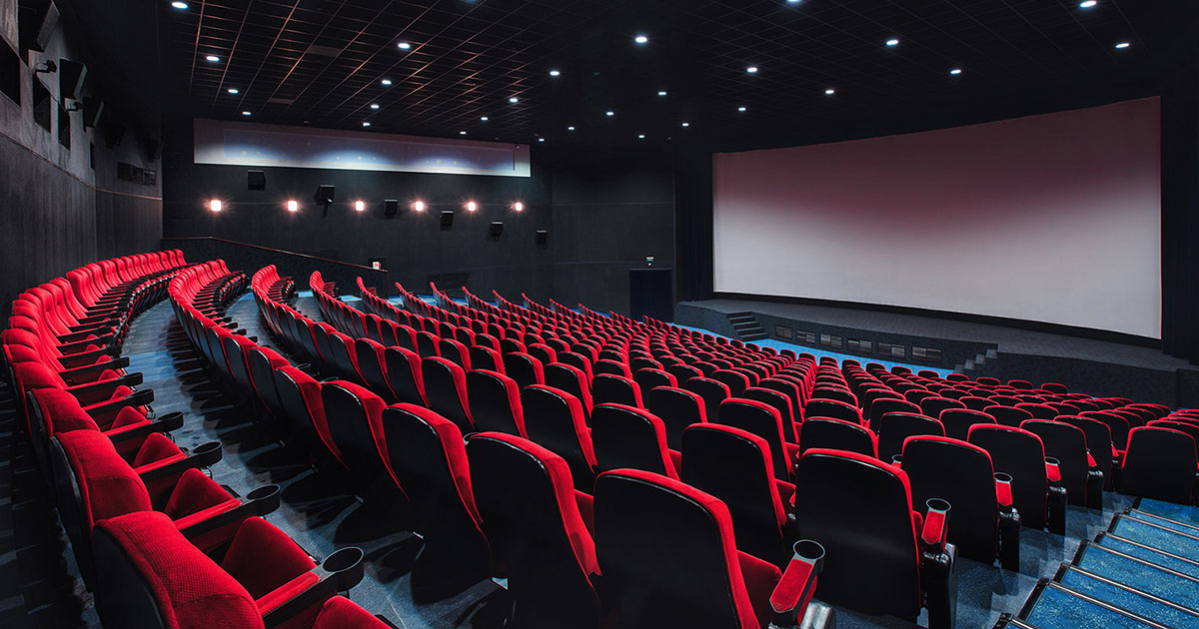
Movie Ticket Management System
Project by : FA20-BSE-073 (ABDUL REHMAN)
FA20-BSE-091 (JAHANZAIB IQBAL)

Slide 2
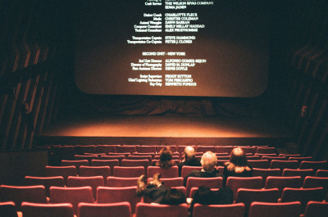
Introduction:
Well, who isn’t a fan of movies? We are certain that everyone is familiar with the process of making an online reservation to watch a movie in theaters. There is no worry if you’re unfamiliar because after this presentation not only will you become aware of the external process but also the immense coding that takes place in the backend to make it all possible.

Slide 3
Basic idea about the working:
Basically, the system works like any reservation system. Any person can view all the available reservation options and select the one they want to watch. They will then view their ticket details along with the bill.
The obvious need for a person to manage all these reservations arises and that such person can add new reservation options or discontinue an ongoing option. They can view the details of all those people who made a reservation .

Slide 4
System Modules:
There are two entities involved in the process, a customer which places a reservation and an admin which manages the whole system; therefore, this project consists of two modules :
Admin Module
Customer Module

Slide 5
Customer Module:
The customer module will cover all the possible functionalities that any user may perform in order to book a ticket through a standard ticket management system, which are :
View all available movies
Search for a movie
Reserve tickets for a movie
View their invoice

Slide 6
Admin Module:
The Admin module covers all those possible functionalities that an admin may need to perform in order to manage and update such a system, which are :
Add a movie
Delete a movie
Search a movie
Edit a movie
View all movies
Search a customer
View all customers

Slide 7
Data Structure:
The data structure we used in our project is singly linked list.
We created two singly linked list, one to store all the data related to a general customers and the other to store all the data related to the movies.
Customers List:
Movies List:
Name
Id
Ph no.
Seat
Date
No. of seats
Bill
Name
Id
Date
Time
Lang
Format
Industry

Slide 8
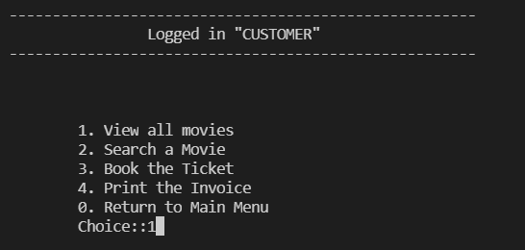
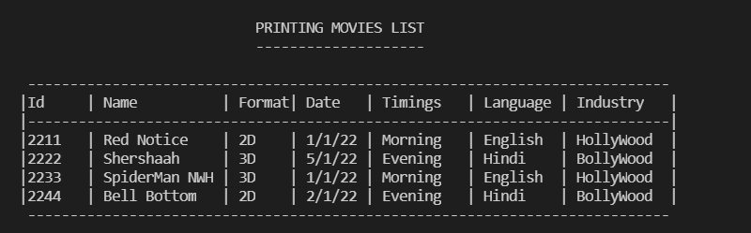
Customer Functionality:
The customer module consists of all these following functionalities explained in detail :
1.View available movies :
To choose one movie the customer needs to know all the options to choose from obviously. When the customer selects this option, all the available movies along with all their detail is displayed to the customer.

Slide 9
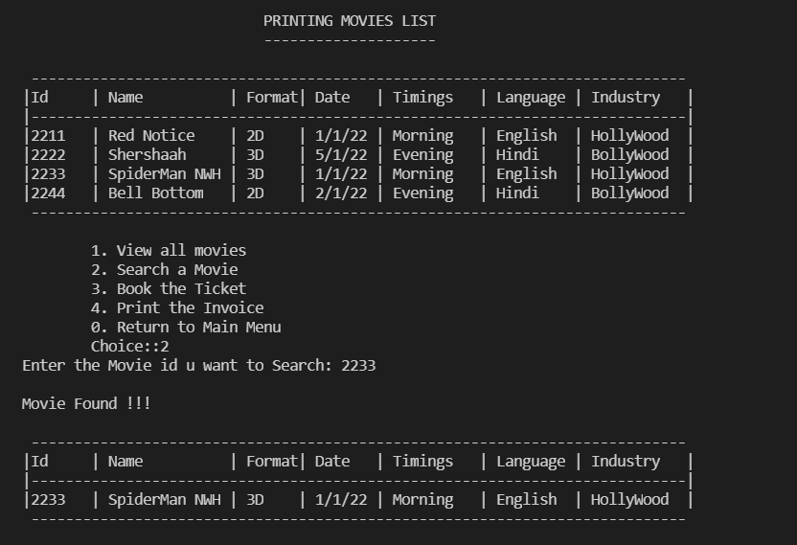
Customer Functionality:
2. Search a movie :
After the customer has viewed all the available movies, they need to select the one they want tickets for and for that they select this feature. The system will ask the customer to insert the id of the movie they want to search. If a correct id is entered the system displays that specific movie’s details.

Slide 10
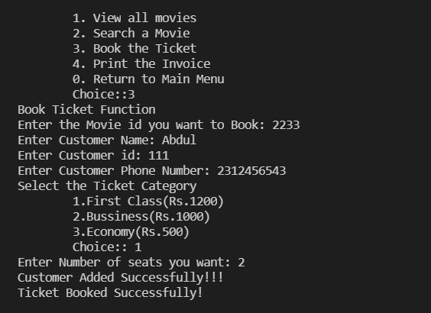
Customer Functionality:
3. Reserve Tickets:
After the customer has selected the movie, they want to reserve tickets for, they then select this feature to place their booking. The system will ask for the movie id, customer name, contact, ticket category, number of seats.

Slide 11
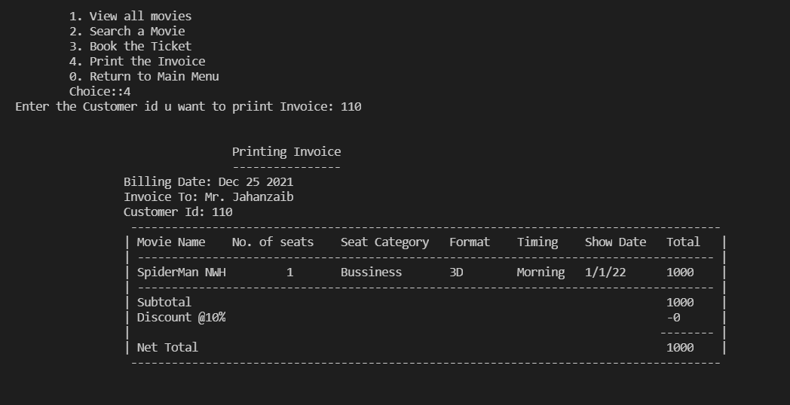
Customer Functionality:
4. Print Invoice:
After the reservation has been made, the customer would want to view the invoice. When the customer selects this option, the system asks for their unique customer id and when it is entered the system displays the bill.

Slide 12

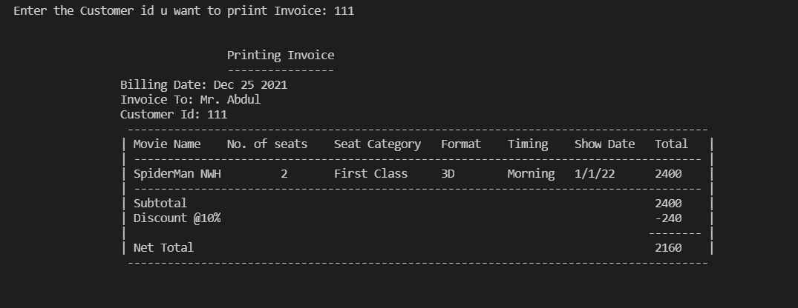
There is a Twist!
There is discount of 10% for every purchase exceeding Rs.2000 to make sure the customers come again :)

Slide 13
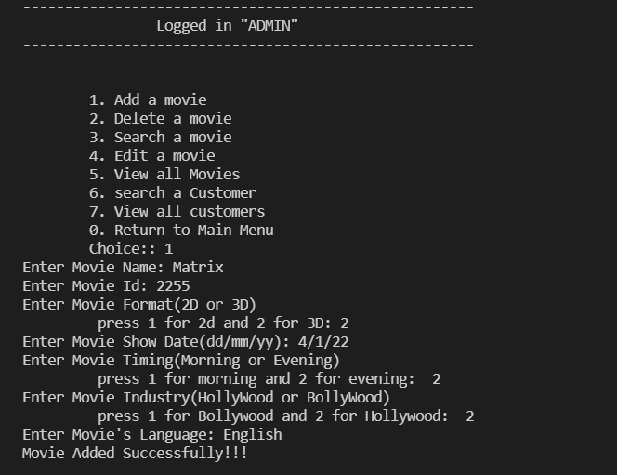
Admin Functionality:
The admin module consists of all these following functionalities explained in detail :
1. Add movie :
Admin must update the system on constant basis so adding a movie is one of the most required feature. The system will ask the admin to enter the movie name, select its unique id, select whether its in 2D or 3D, its date and the movie’s time ( morning/evening), movie’s industry (Hollywood/Bollywood) and its language.

Slide 14
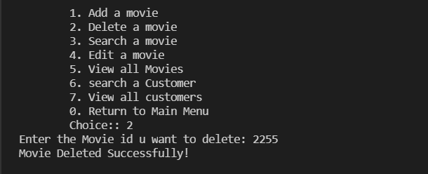
Admin Functionality:
2. Delete a movie :
Just like there is the need to update the system with new movies, the admin needs to delete the movies which have been played. For this feature the admin will just need to enter the unique id assigned to that particular movie and it will be deleted.

Slide 15
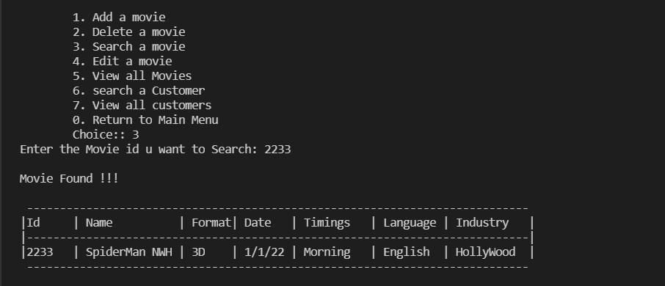
Admin Functionality:
3. Search a movie :
The system will ask the admin to insert the id of the movie they want to search. If a correct id is entered the system displays that specific movie’s details.

Slide 16
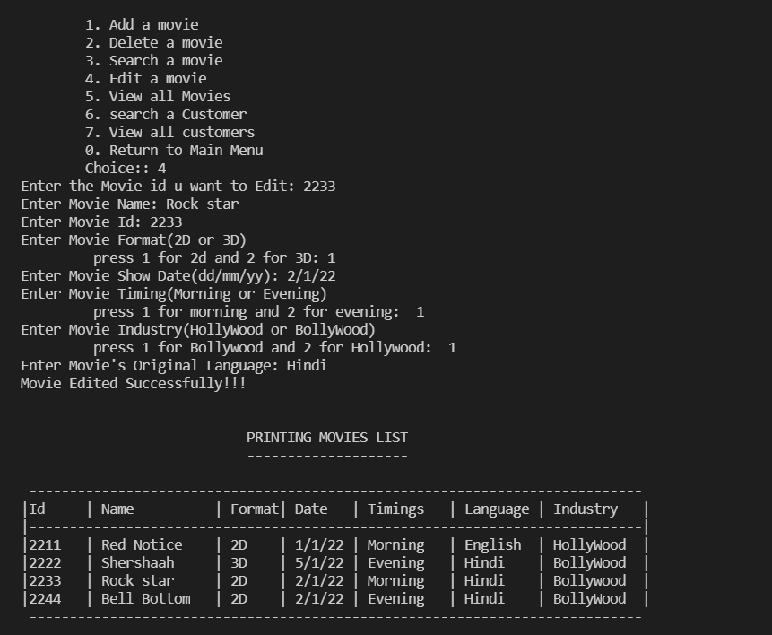
Admin Functionality:
4. Edit a movie :
The system will ask the admin to insert the id of the movie they want to edit. If a correct id is entered the system will ask the admin to enter a new movie name, id, format, time, industry, language in its place. If the admin wants to just make a slight change, then he will have to enter the rest of the details as they were and make the change in the desired part only.

Slide 17
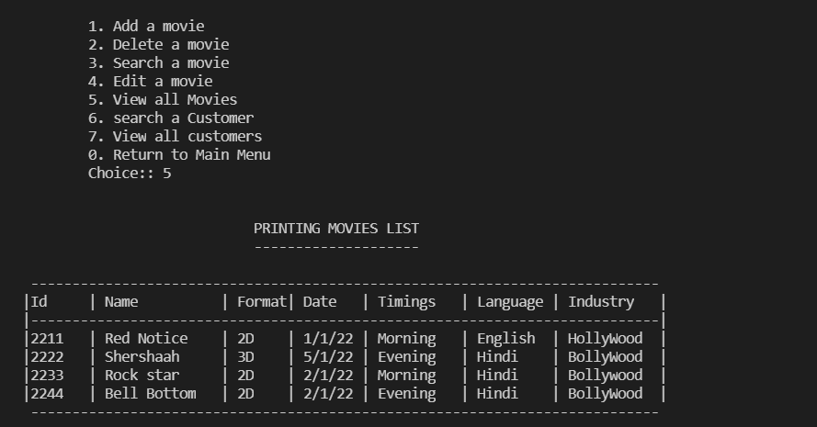
Admin Functionality:
5. View all movie :
Admin may want to view all the movies planned currently. When the admin selects this option, all the available movies along with all their detail is displayed to the admin.

Slide 18
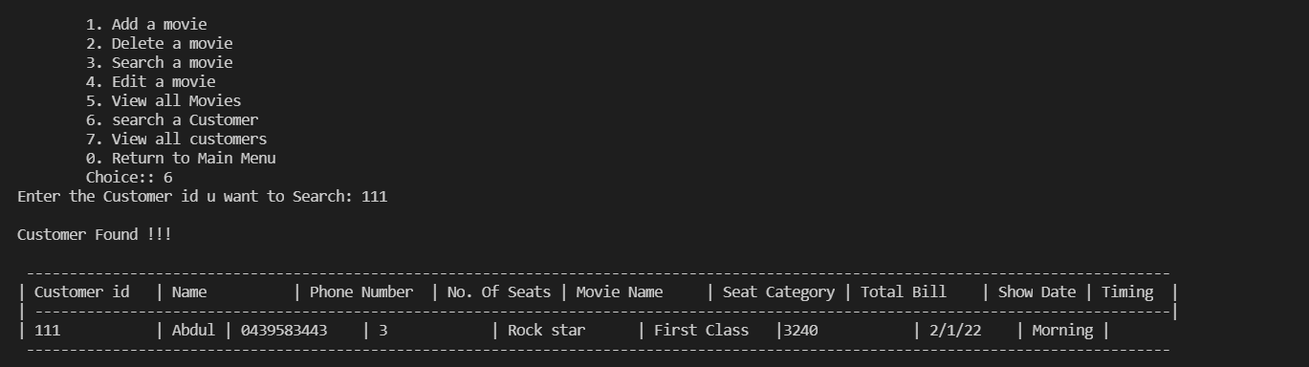
Admin Functionality:
6. Search a Customer:
Admin may want to view the data related a specific customer. When the admin selects this option, the system will ask the admin to enter the unique id of the specific customer. If the correct id is entered the customer’s data will be displayed.

Slide 19
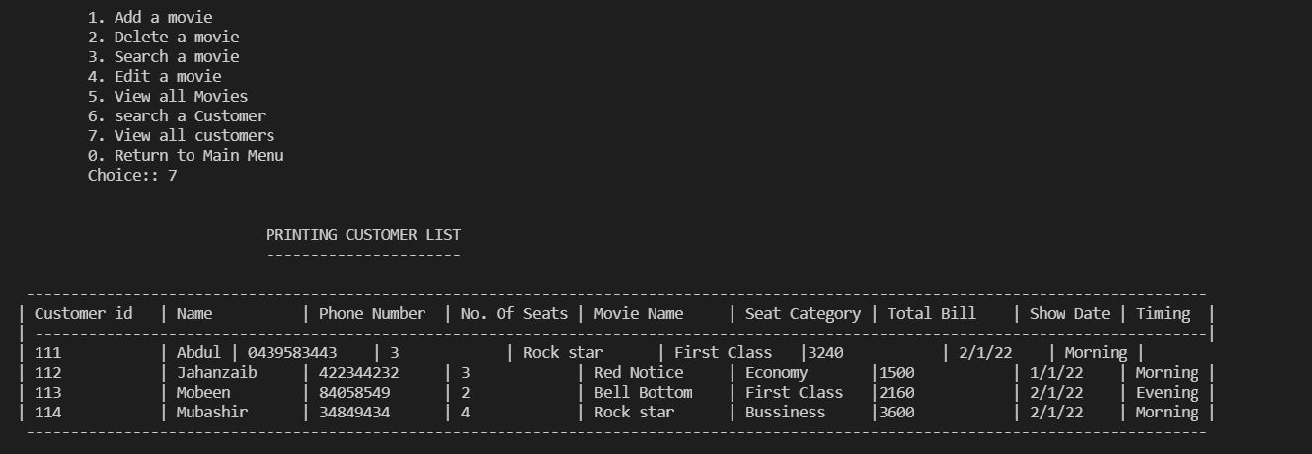
Admin Functionality:
7. View all Customers:
Admin may want to view the data of all the registered customers. When the admin selects this option, the system will display all the registered customers data in the system.

Slide 20
Thank You

